Slide 1
Why do I eat?
Where do I invest my energy?
When do I want to eat?
Mindful
Eating Cycle
How much do I eat?
What do I eat?
How do I eat?

Slide 2
We Share Food

Slide 3
Introduction
This is a food sharing and help with healthy eating website.
Area - Concentrated on locally.
Revenue – Accept individual or group orders, food delivery, and onsite cooking.
– Expand and accept business to join the platform.
We Share Food
Future Growth

Slide 4
Expected List of Features
We Share Food
Language & Features | Home page | Food Menu | Community Share | Contact us
Bootstrap(HTML/CSS/JS | Yes (Behavior Analysis , Online Chatting) | Yes | Yes | Yes
React/React Native | Yes | Yes | Yes | Yes
Mongo DB | Yes | Yes | Yes | Yes
Middleware | AWS (Docker)
Notes:
On the home page, using animation function to display the images, a section to display user behaviors analysis and a place to put describe who we are.
Food menu - Images and detail of receipt.
Community Share – To find your neighbors, or to join a group you interested.
Feedback & Online chatting – Designed on every page.
Contact us – registration form to contact us or select to be a member of our website.

Slide 5
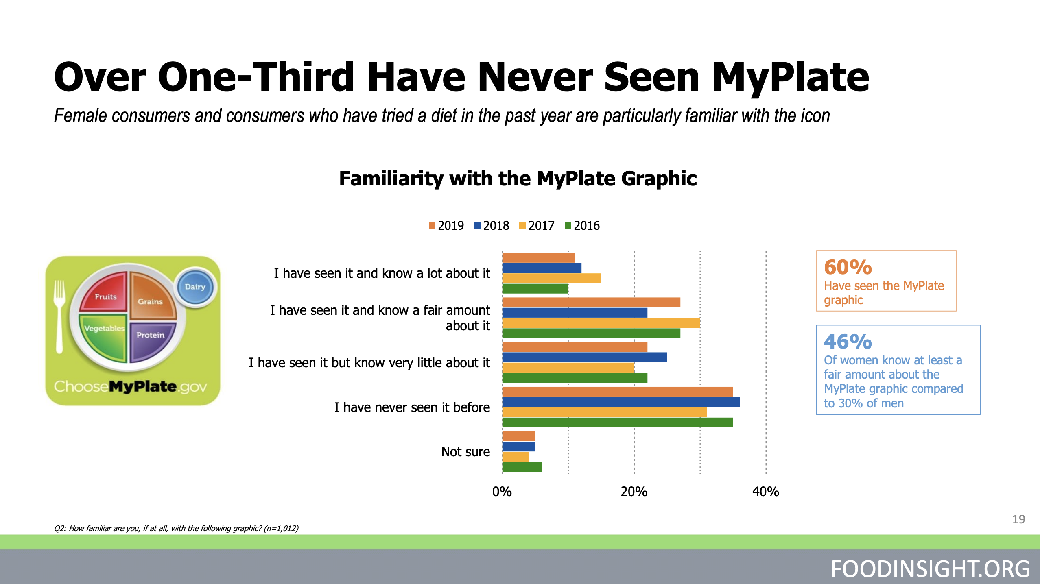
Market Survey
We Share Food
1 | https://www.squarespace.com/templates/online-stores
2 | http://www.ladyslippercottages.com/

Slide 6
References
INFO:
ihttps://foodinsight.org/wp-content/uploads/2019/05/IFIC-Foundation-2019-Food-and-Health-Report-FINAL.pdf
IMG:
https://www.createsoulbalance.com/its-not-just-what-you-eat-but-why/
Website:
https://sunnoodle.com/
We Share Food

